Slide 1
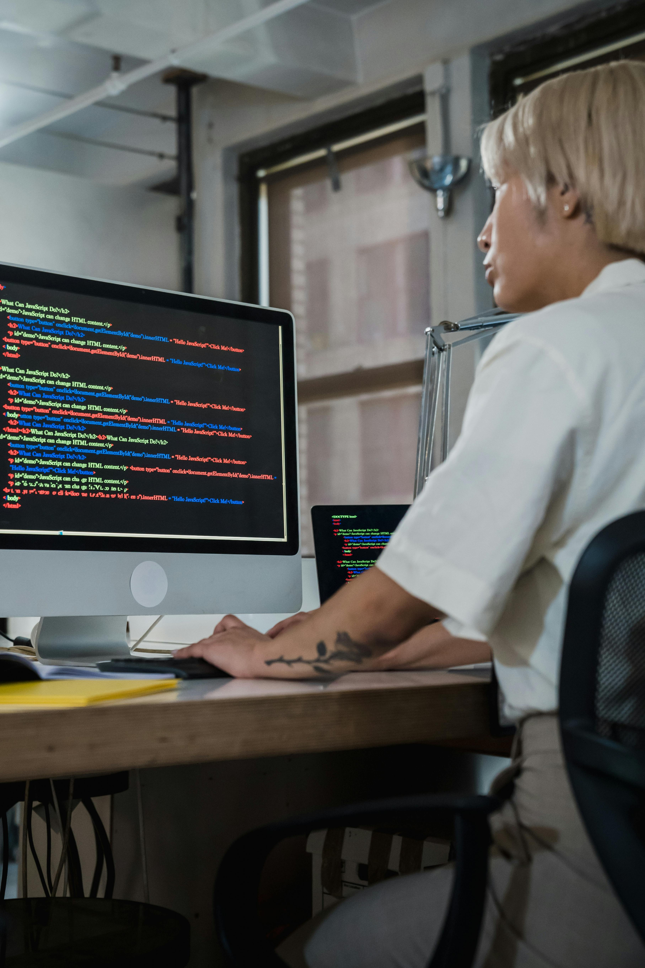
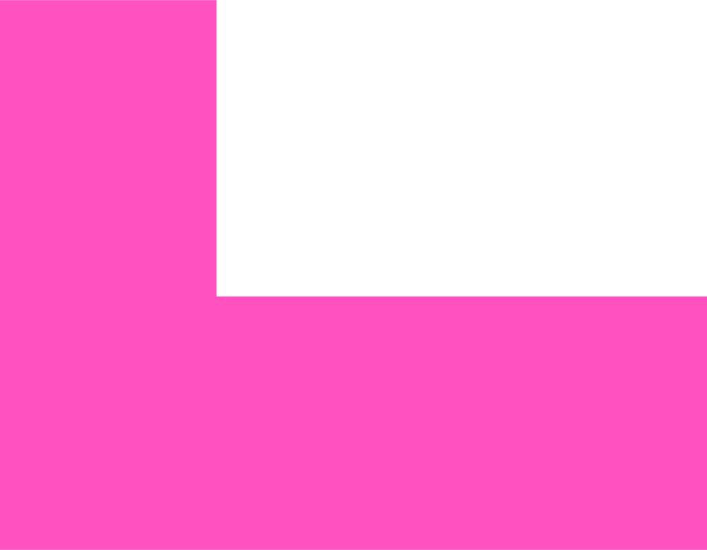
Software Engineering
Day2 – Requirements & Design
Understanding the Foundation of Modern Technology

Slide 2
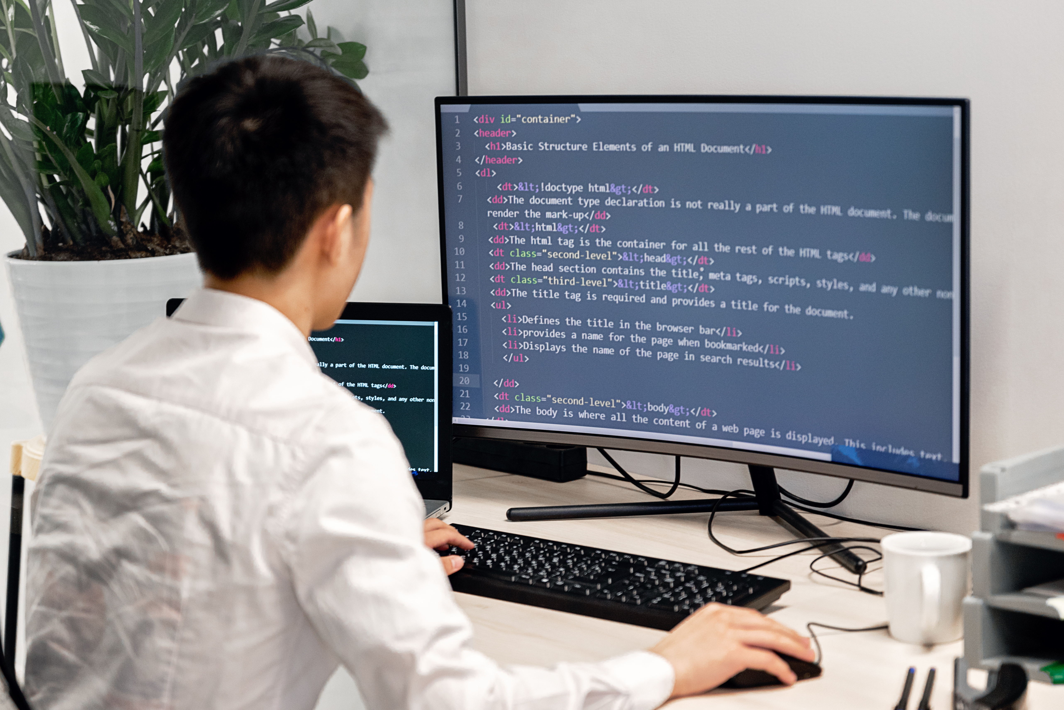
Wellcome Back!
Quick Recap – Day 1
✅ SE Fundamentals: Modularity, Abstraction, Encapsulation, Separation of Concerns
✅ Project Structure: Clean organization with MVC principles
✅ Development Environment: Ready to code!
🎯 Today's Mission
”Learn how to understand what users really want and design systems that deliver it!”
📋 Today's Agenda
Requirements Analysis & User Stories
System Design & Architecture
Design Patterns Introduction
Hands-on: Apply to our Task Manager
Notes:
Code yang tidak bisa di-debug
Project yang tidak pernah selesai
Kerja sama tim yang kacau
Code yang sulit dipahami setelah beberapa bulan

Slide 3
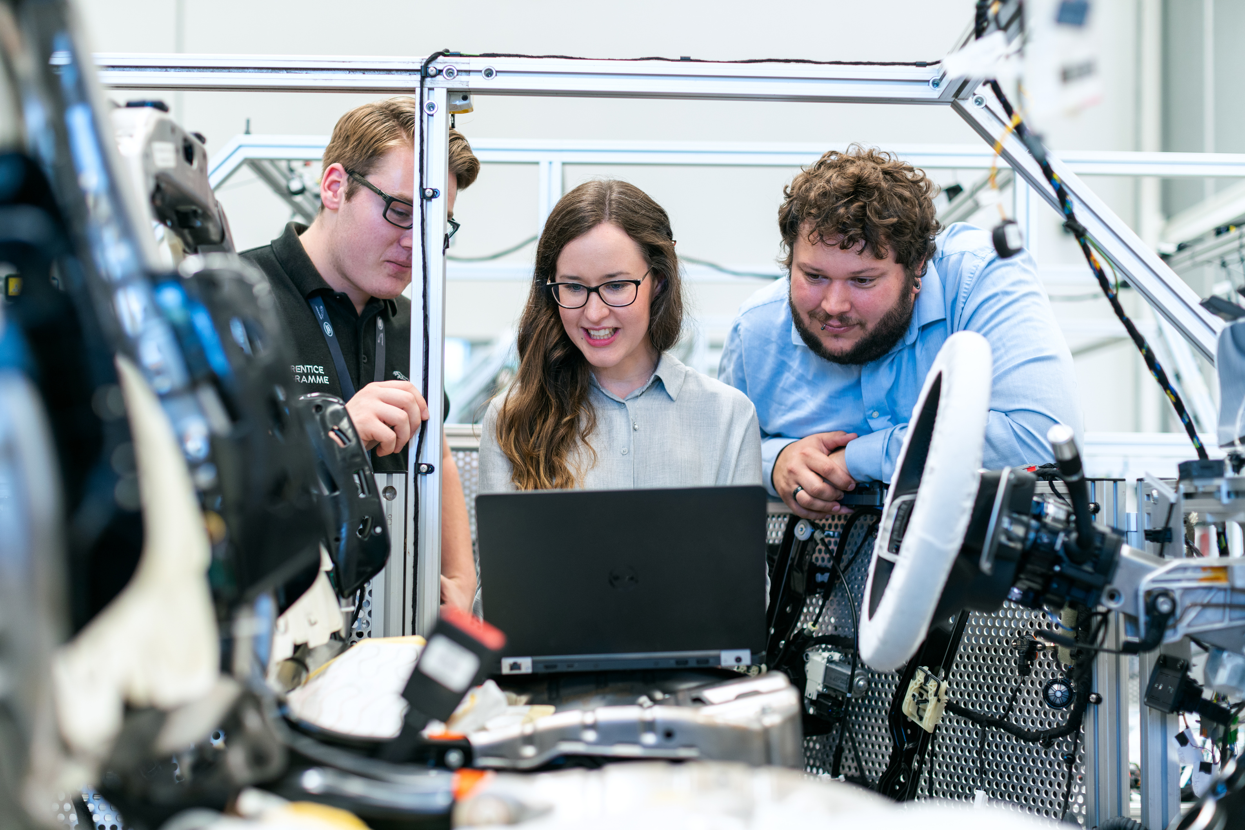
The Requirements Problem
"Why do 70% of software projects fail?"
😱 Horror Stories
London Ambulance Service (1992): Poor requirements led to system failure, lives lost
Berlin Airport (2012-2020): 8 years late, €7 billion over budget
Your Experience: "Aplikasi yang dibuat tidak sesuai yang diminta dosen?”
Website Pendaftaran CPNS: Crash saat dibuka, requirements tidak anticipate traffic
Sistem SIAKAD kampus: Sering tidak sesuai workflow mahasiswa yang sebenarnya
🤔 Root Cause Analysis:
Bahasa tidak spesifik: "Bikin yang bagus ya" - apa definisi "bagus"?
Tidak riset user: Assume user behavior tanpa validasi
Skip stakeholder analysis: Tidak tahu siapa yang actually akan pakai
Cultural assumptions: Assume semua user tech-savvy seperti developer

Slide 4
What are requirements?
The Blueprint of Software
🏗️ Building Analogy
Architect: Understands what client wants
Blueprint: Detailed plans and specifications
Builder: Follows blueprint to construct
Result: House that meets client's needs
💻 Software Equivalent
Business Analyst: Understands user needs
Requirements: Detailed specifications
Developer: Implements according to requirements
Result: Software that solves real problems

Slide 5
Types of Requirements
Functional vs Non-Functional
⚙️ Functional Requirements
What the system should DO
User can create a task
System sends email notifications
Admin can delete any user account
Search returns relevant results
🎯 Non-Functional Requirements
How the system should PERFORM
Response time < 2 seconds
Support 1000 concurrent users
99.9% uptime
Mobile-friendly interface
GDPR compliant

Slide 6
Requirements Gathering Techniques
How to Discover What Users Really Want
🗣️ User Interviews
🎨 Prototyping
Pros: Deep insights, clarify ambiguity
Cons: Time-consuming, small sample size
Best for: Understanding user workflows
Pros: Deep insights, clarify ambiguity
Cons: Time-consuming, small sample size
Best for: Understanding user workflows
👀 Observation
📊 Surveys
Pros: See actual behavior, not reported behavior
Cons: Hawthorne effect (people act differently when watched)
Best for: Understanding current pain points
Pros: Visual feedback, early validation
Cons: Users focus on UI, not functionality
Best for: Complex or innovative features

Slide 7
User Stories Format
The Industry Standard
📝 Template
✅ Good Example
As a [type of user]
I want [some goal]
So that [some reason/benefit]
As a busy student
I want to set task deadlines
So that I can prioritize my work effectively
Kenapa pakai format ini?
❌ Bad Example
As a: Siapa yang butuh fitur ini? (mahasiswa, dosen, admin)
I want: Apa yang mau dilakukan? (login, upload tugas, lihat nilai)
So that: Kenapa butuh fitur ini? (biar bisa akses sistem, submit tugas tepat waktu)
As a user
I want a button
So that I can click it
Langkah-langkah menulis User Story:
Identifikasi user: Siapa yang akan pakai fitur ini?
Tentukan goal: Apa yang mau user lakukan?
Cari alasan: Kenapa user butuh ini? Apa benefitnya?

Slide 8
User Stories Format
INVEST Criteria
🎯 I - Independent
Story can be developed separately
🗣️ N - Negotiable
Details can be discussed and refined
💰 V - Valuable
Provides clear value to user/business
📏 E - Estimable
Team can estimate effort required
🤏 S - Small
Can be completed in one sprint
✅ T - Testable
Clear acceptance criteria

Slide 9
Interactive Exercise
Write User Stories for WhatsApp
🤔 Think About These Features:
Sending messages
Creating group chats
Sharing photos
Voice messages
Status updates
🎯 What We're Looking For:
Clear user type dan benefit
Testable acceptance criteria
Focus on user value, not technical implementation

Slide 10
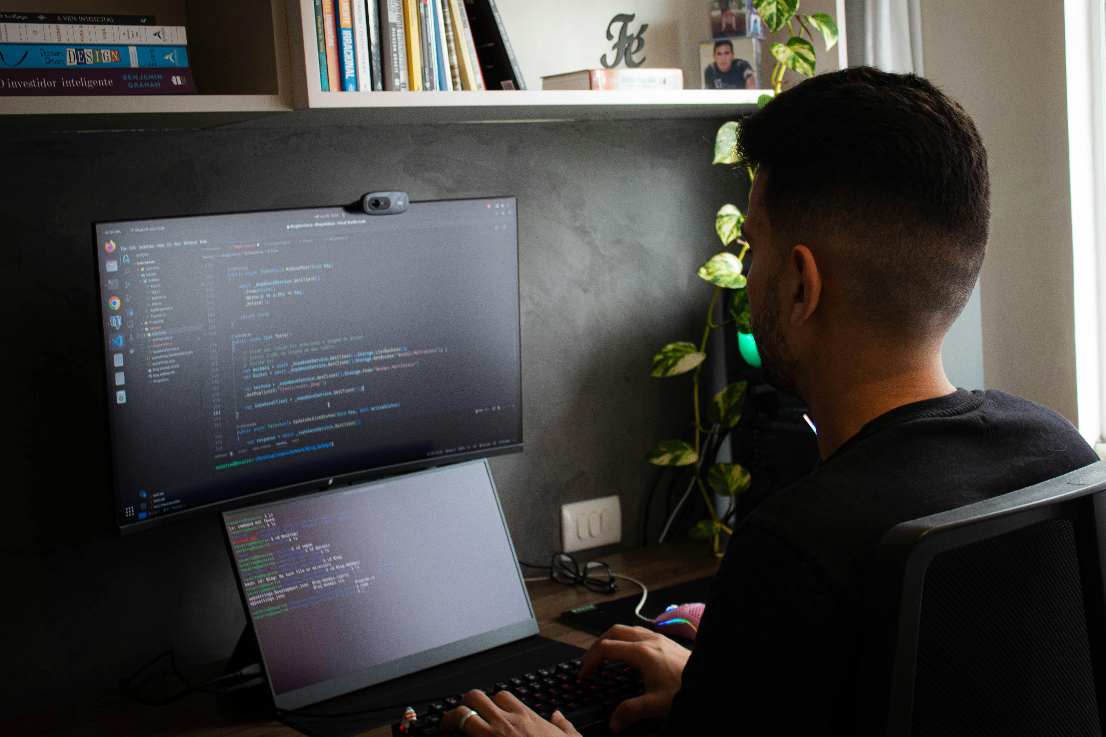
Quiz Time!
1. What's the difference between functional and non-functional requirements?
A) No difference
B) Functional = what, Non-functional = how
C) Functional is more important
2. Which is a better user story?
A) "As a user, I want a login page"
B) "As a student, I want to securely access my tasks so that my data is protected"
3. What makes acceptance criteria good?
A) Very detailed technical specifications
B) Testable conditions that define "done"
C) Long descriptions of every possible scenario

Slide 11
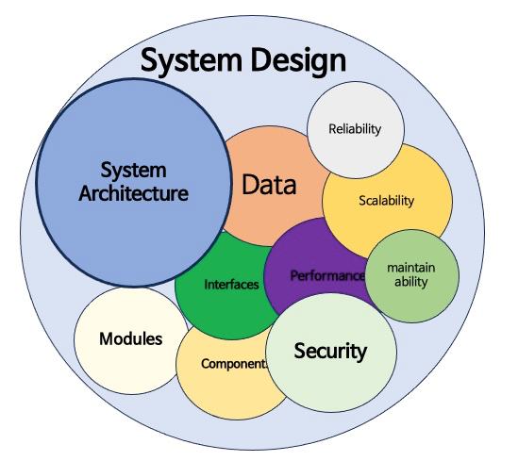
System Design Introduction
From Requirements to Architecture
🏗️ What is System Design?
The process of defining:
Components: What parts make up the system
Interfaces: How parts communicate
Data flow: How information moves through system
Technology choices: What tools and frameworks to use
🎯 Goals of Good Design
Maintainable: Easy to modify and extend
Scalable: Can handle growth
Testable: Components can be tested independently
Understandable: New team members can quickly contribute

Slide 12
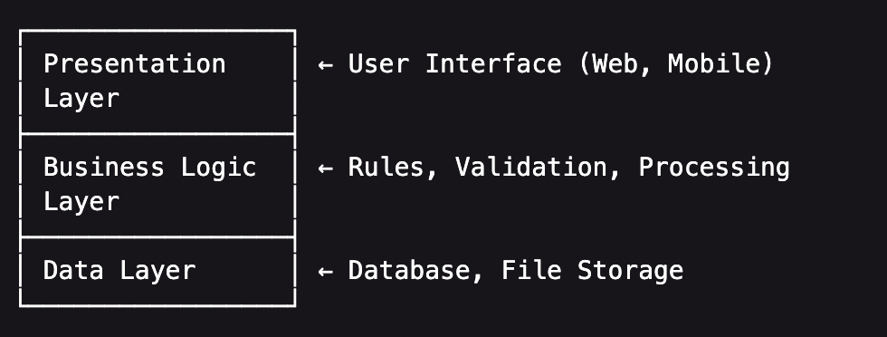
High-Level Architecture
The Big Picture
🍽️ Restaurant Analogy
Waiter (Presentation): Takes orders, serves food
Chef (Business Logic): Prepares food, follows recipes
Pantry (Data): Stores ingredients
✅ Benefits
Clear separation of concerns
Each layer can be modified independently
Easier to test and maintain

Slide 13
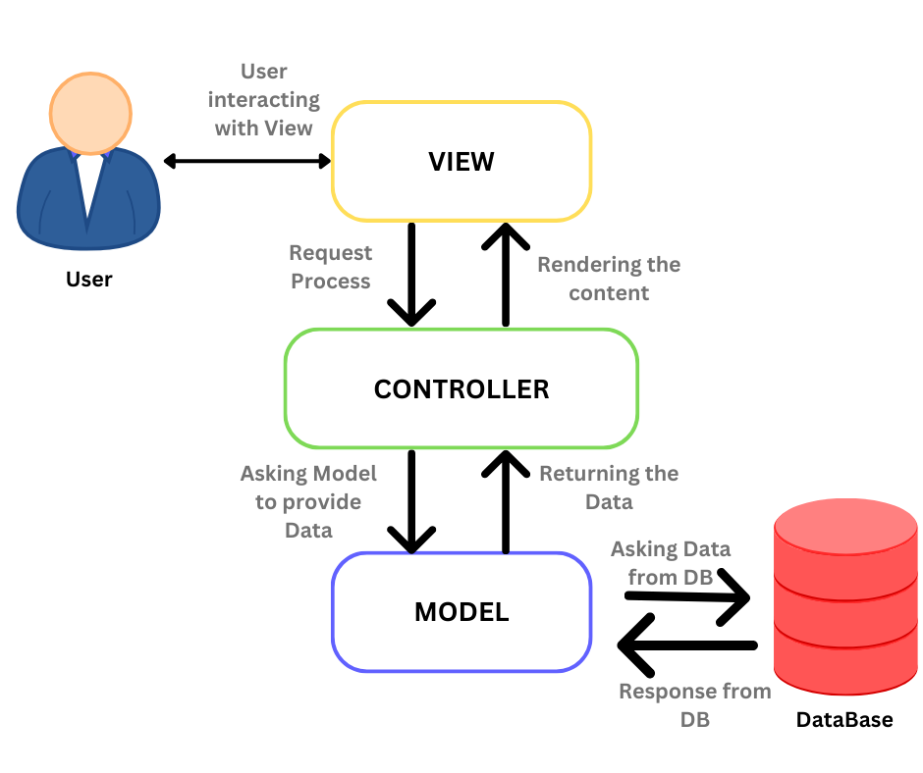
MVC Pattern Introduction
Model-View-Controller
📊 Model
Represents data and business logic
Independent of user interface
Example: Task, User, Category classes
👁️ View
Presents data to user
Handles user interface
Example: HTML pages, mobile screens
🎮 Controller
Handles user input
Coordinates between Model and View
Example: TaskController, UserController

Slide 14
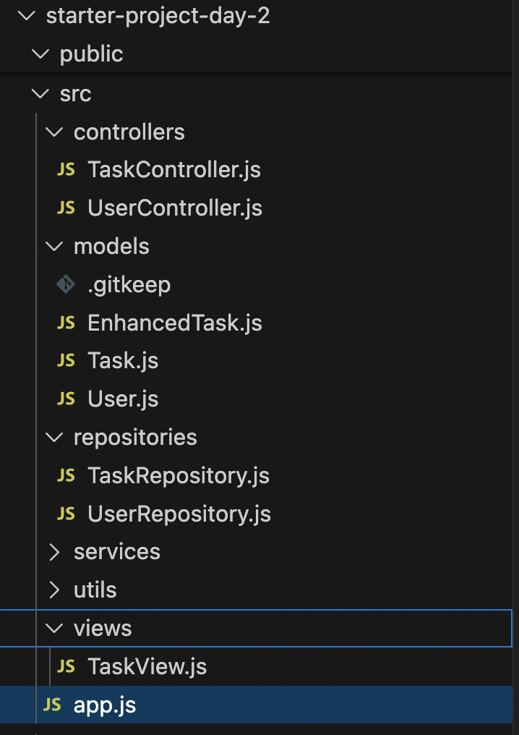
MVC in Our Task Manager
Concrete Example
📋 Task Creation Flow
User clicks "Create Task" → Controller receives request
Controller validates input → Calls TaskService
TaskService applies business rules → Calls TaskRepository
TaskRepository saves to database → Returns Task object
Controller formats response → Sends to View
View displays success message → User sees confirmation

Slide 15
Repository Pattern
Abstracting Data Access
🤔 The Problem
What if we want to switch from SQLite to PostgreSQL?
What if we want to add caching?
How do we test without a real database?
💡 The Solution: Repository Pattern
class TaskRepository {
create(taskData) { /* implementation */ }
findById(id) { /* implementation */ }
findByUserId(userId) { /* implementation */ }
update(id, updates) { /* implementation */ }
delete(id) { /* implementation */ }
}
✅ Benefits
Abstraction: Business logic doesn't know about database details
Testability: Can use mock repository for tests
Flexibility: Easy to switch data storage solutions

Slide 16
Design Pattern Benefits
Why Patterns Matter
🗣️ Common Language
"We're using MVC" → Everyone understands structure
"Let's add a Repository" → Clear what needs to be done
Faster communication in teams
🔄 Proven Solutions
Patterns solve recurring problems
Battle-tested in thousands of applications
Avoid reinventing the wheel
📚 Learning Accelerator
Understanding patterns helps you read other codebases
Easier to onboard new team members
Industry standard practices
⚠️ Warning: Don't Over-Engineer
Use patterns when they solve real problems
Start simple, add complexity when needed
"Premature optimization is the root of all evil"

Slide 17
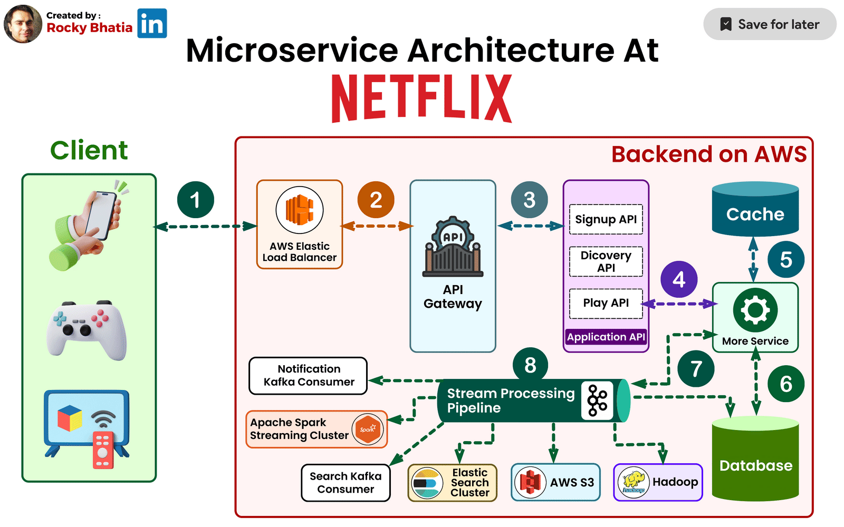
Real-World Design Example
How Netflix Applies These Concepts
🎬 Netflix Architecture (Simplified)
Presentation: Web app, mobile apps, smart TV apps
Business Logic: Recommendation engine, user management, content delivery
Data: User profiles, viewing history, content metadata
🧩 Microservices Pattern
User Service: Handle user accounts
Recommendation Service: Suggest content
Streaming Service: Deliver video content
Billing Service: Handle subscriptions
📈 Scale Considerations
200+ million users worldwide
Billions of hours watched monthly
99.9% uptime requirement
Global content delivery
Key Insight: Good design principles scale from small projects to global platforms!

Slide 18
Common Design Mistakes
Learn from Others' Pain
🍝 Spaghetti Code
No clear structure
Everything depends on everything
Impossible to test or maintain
😱 The "God Class" Anti-Pattern
class TaskManager {
createUser() { /* ... */ }
authenticateUser() { /* ... */ }
createTask() { /* ... */ }
sendEmail() { /* ... */ }
generateReport() { /* ... */ }
// ... 50 more methods
}
Problem: Violates Single Responsibility Principle
🔧 Premature Optimization
Adding complexity before it's needed
"We might need to scale to millions of users"
Start simple, optimize when you have real problems

Slide 19
Questions & Discussion

Slide 20
What We'll Build Today
Learn from Others' Pain
📋 Requirements Gathering
Brainstorm Task Manager features
Write user stories with acceptance criteria
Prioritize features for MVP
🏗️ System Design
Create architecture diagram
Implement MVC structure
Add Repository pattern
💻 Code Implementation
Update Task model with new requirements
Create User model
Implement TaskRepository and TaskService
Create basic TaskController
✅ Success Criteria
Clear requirements document
Working MVC structure
Basic CRUD operations implemented

Slide 21
Day 2 Wrap-up
Learn from Others' Pain
🧠 Concepts Learned
Requirements analysis and user stories
System architecture and design patterns
MVC and Repository patterns
Design trade-offs and best practices
💻 Practical Skills
Writing effective user stories
Implementing MVC structure
Applying Repository pattern

Slide 22

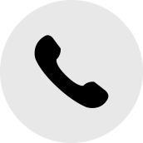


Thank You
Get In Touch
+62-822-1367-2972
http://toni.Kusnandar.dev
toni@Kusnandar.dev

